Slide 1
Software Life Cycle Models
Waterfall model
Agile model
Spiral model
V-model

Slide 2
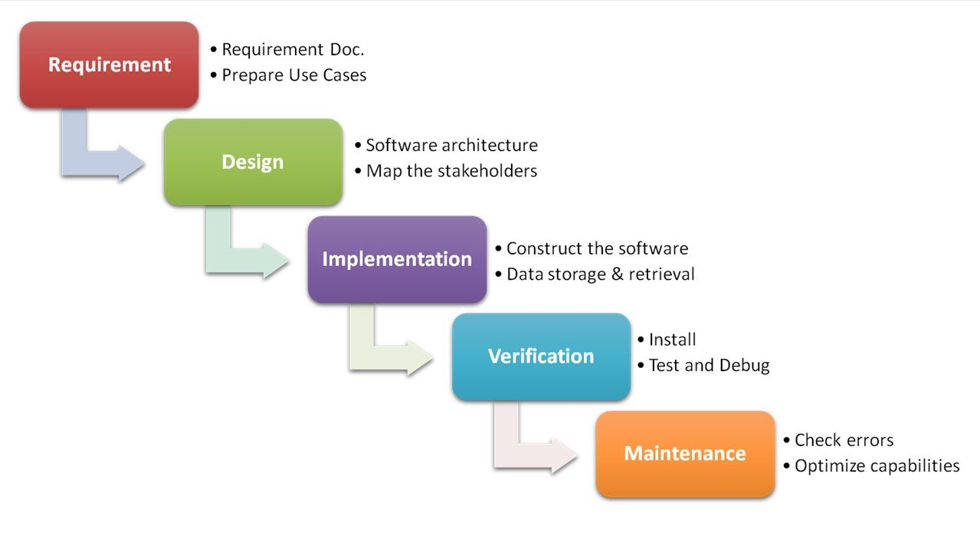
Waterfall model

Slide 3
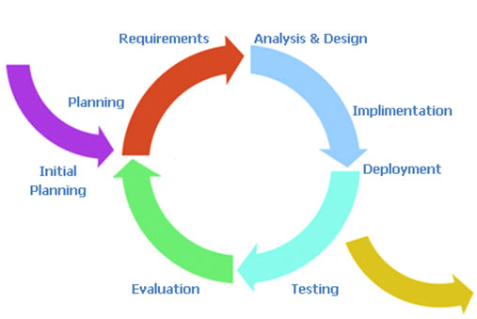
Agile model

Slide 4
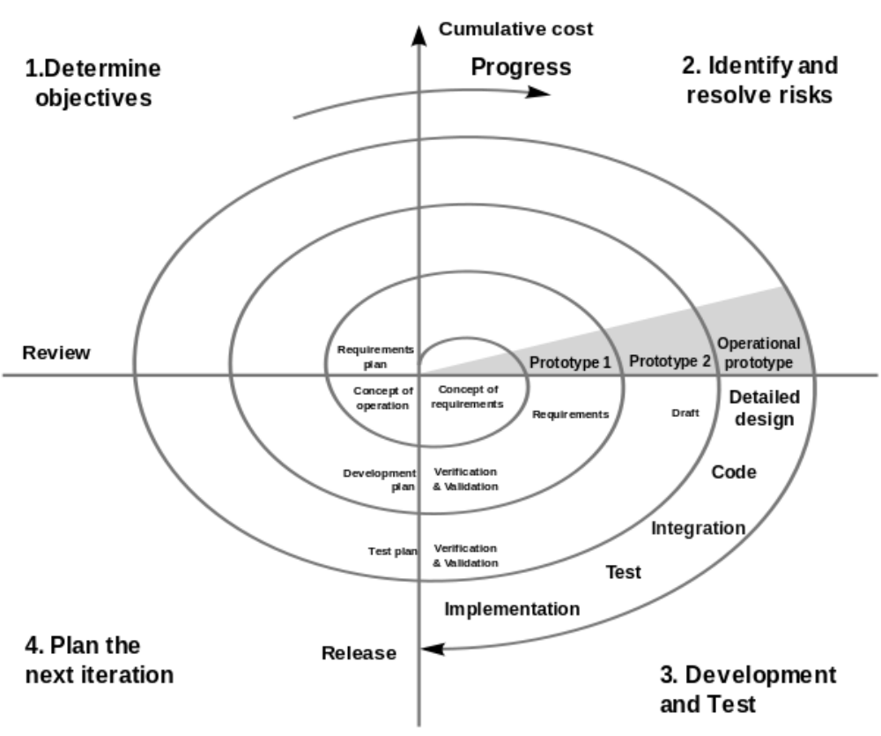
Spiral model

Slide 5
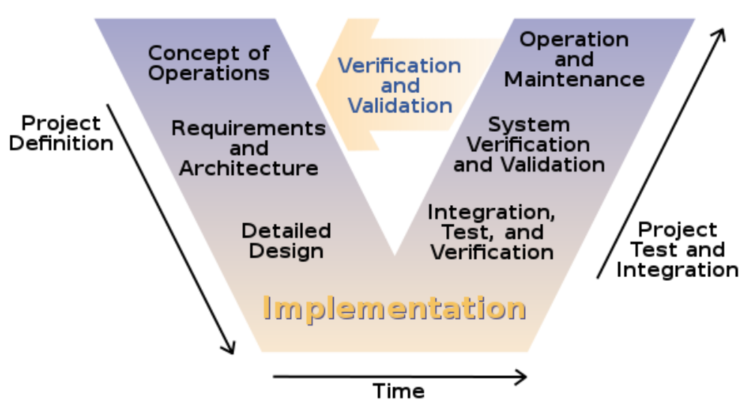
V-model

Slide 6
Comparison of methods by criteria
Factors | Waterfall model | Agile model | Spiral model | V-model
Unclear user requirement | Poor | Excellent | Excellent | Poor
Unfamiliar technology | Poor | Poor | Excellent | Poor
Complex system | Good | Poor | Excellent | Good
Reliable system | Good | Good | Excellent | Good
Short time schedule | Poor | Excellent | Excellent | Poor
Strong project management | Excellent | Excellent | Excellent | Excellent
Cost limitation | Poor | Excellent | Poor | Poor
Visibility of stake holders | Good | Excellent | Excellent | Good
Skills limitation | Good | Poor | Poor | Good
Documentations | Excellent | Poor | Good | Excellent
Component reusability | Excellent | Poor | Poor | Excellent

